Slide 1


The role of AI in the education system
Beyond Borders
Korean- Georgian Youth Camp - 7/4-7/8
Paata Gogishvili
Doctor of Informatics, Associate Professor
Ilia State University

Slide 2
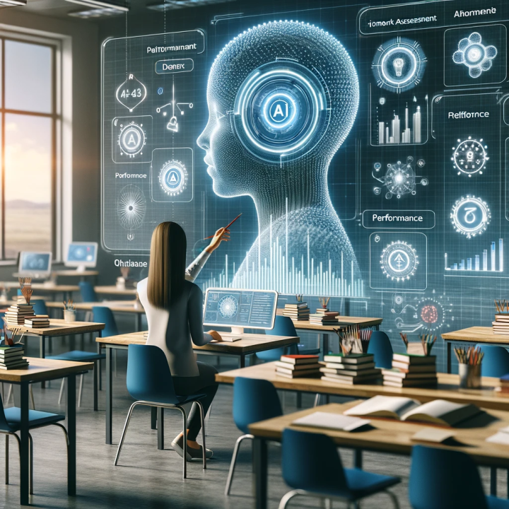

Slide 3

Artificial Intelligence is Changing Our Lives!
Soon, Everything Will Be Different!
We Must Prepare Now!

Slide 4
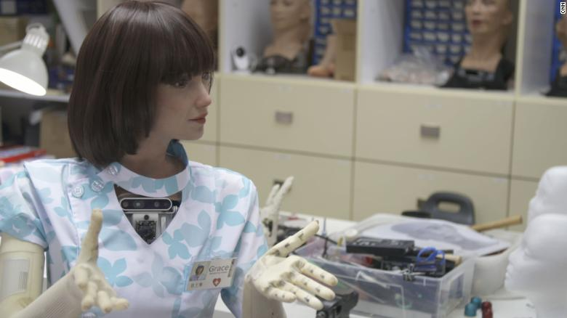
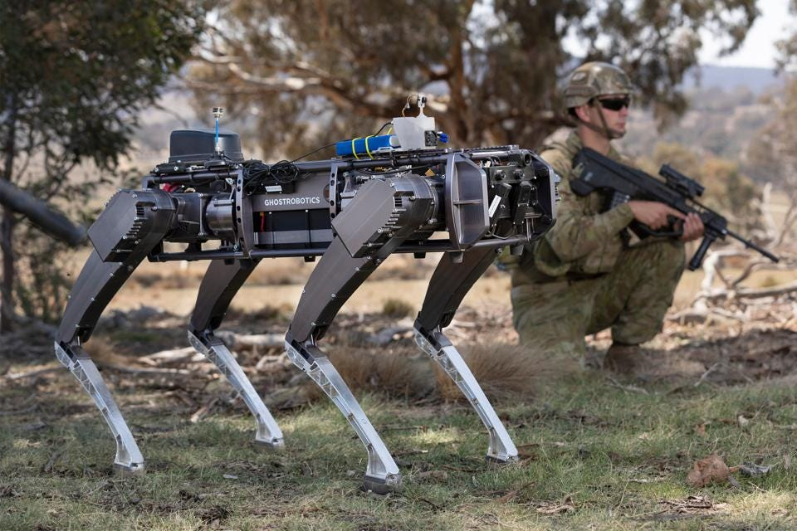
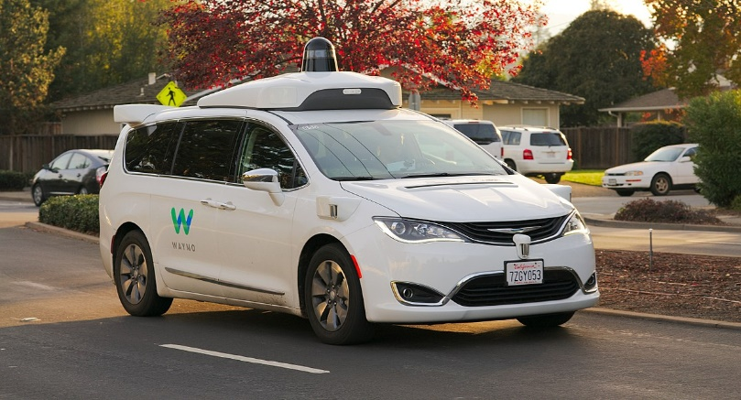
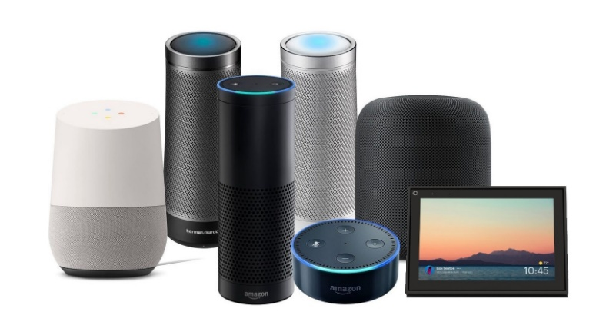


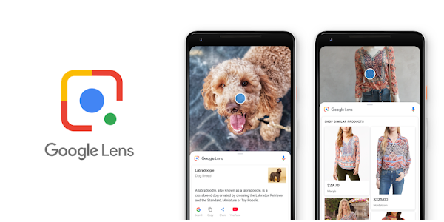
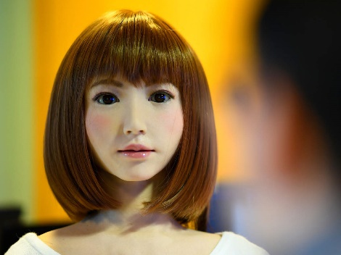
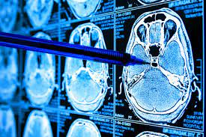
This is Already a Reality
Robot Dog
Self-Driving Car
Robot Nurse
Digital Assistant
Voice-Activated Glasses
Surveillance Cameras
Google Lens
Human-Like
Medical Diagnostics

Slide 5
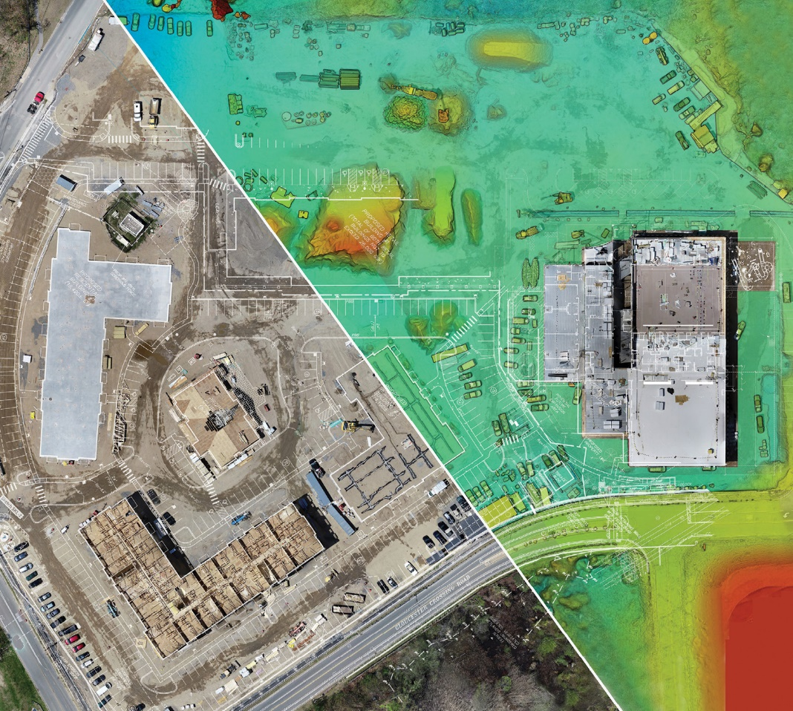
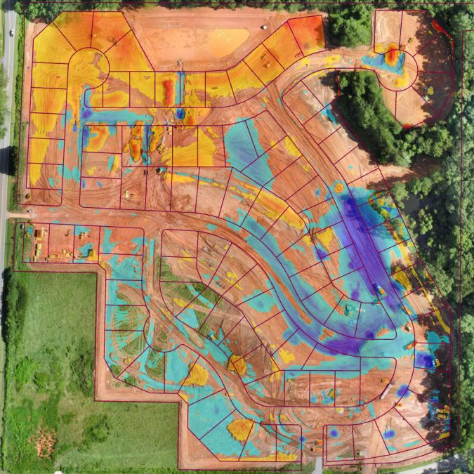
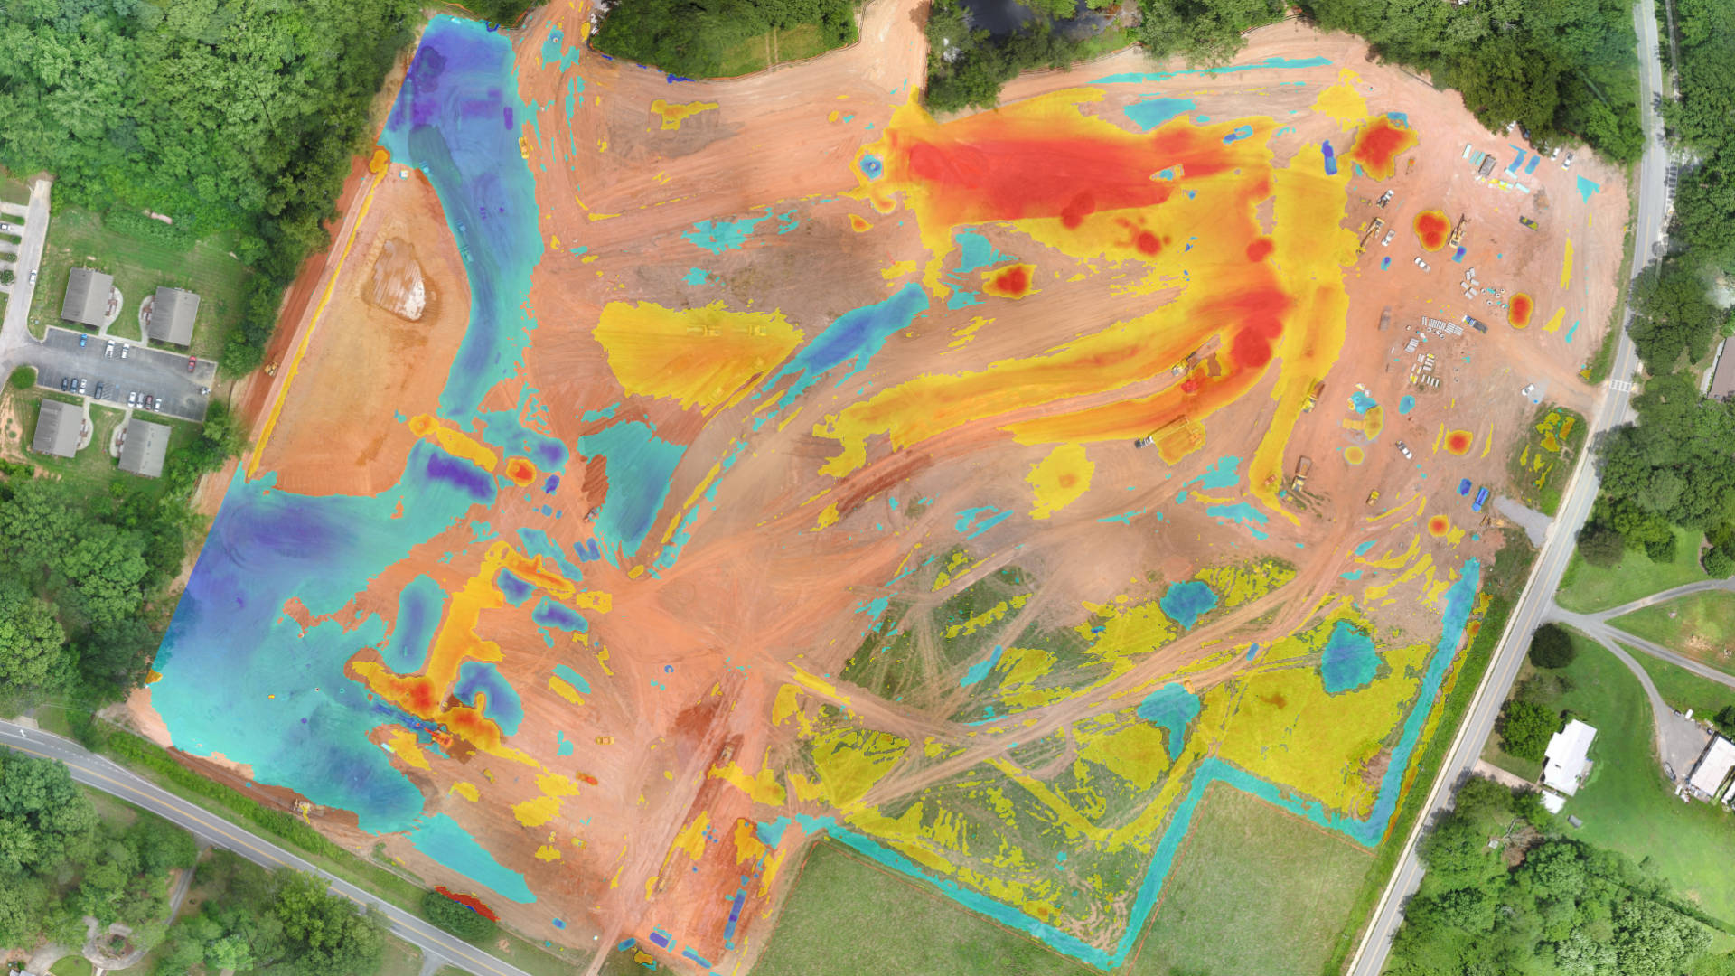


Military Sector

Slide 6
Artificial Intelligence Learns Exactly the Way We Do!

Slide 7
We learn to walk, talk, read, and write.
We master various professions.
Artificial Intelligence learns everything we provide data for!

Slide 8
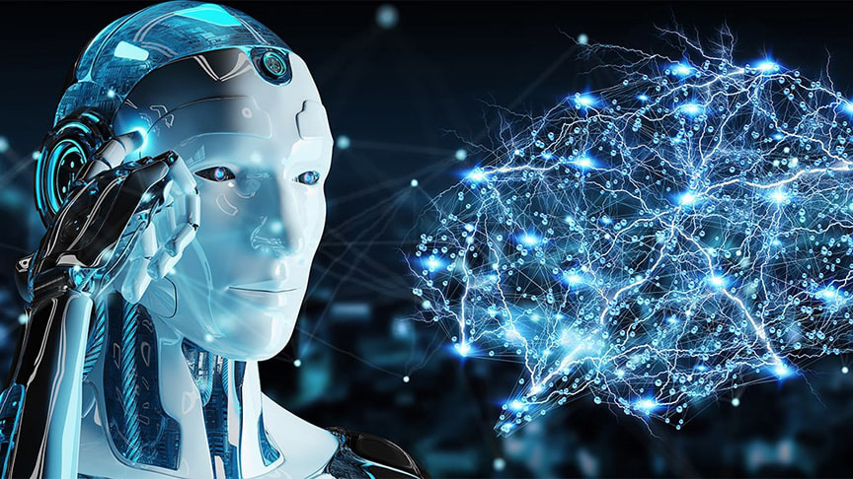
The key technology is the neural network

Slide 9
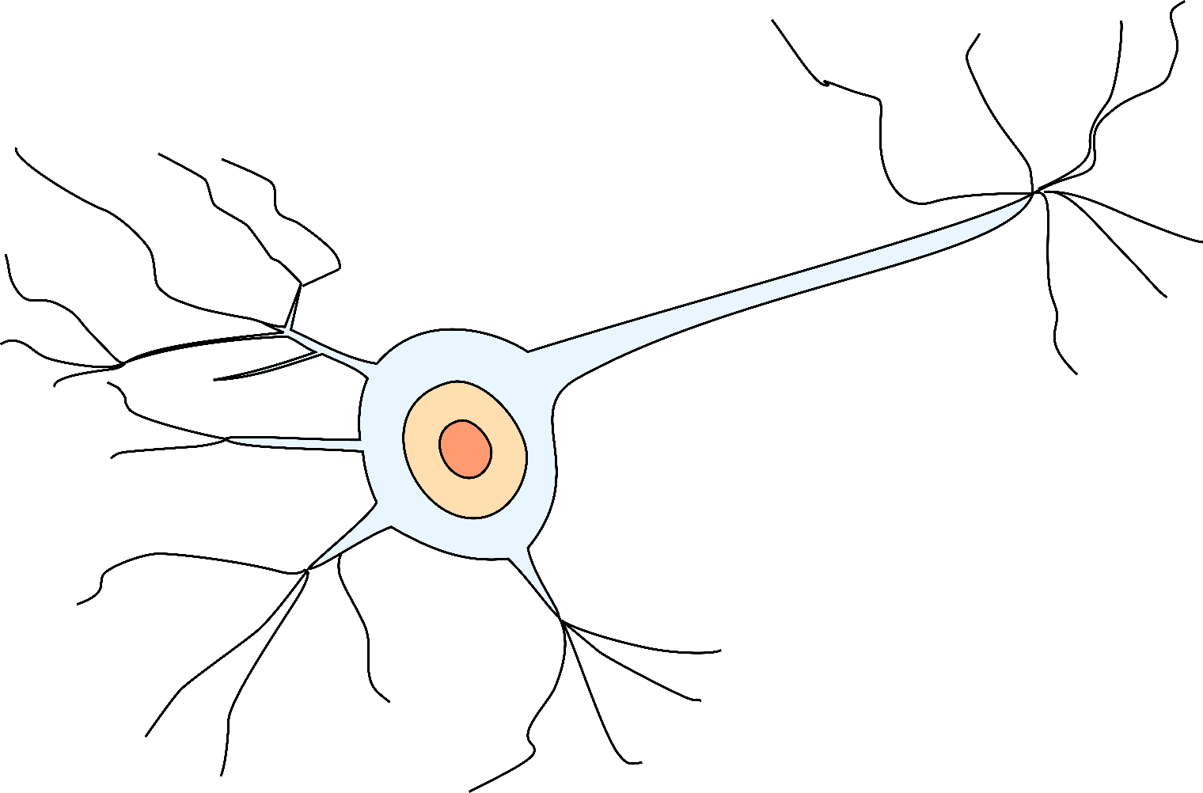
Natural Neuron
Dendrites
Axon
Dendrites
Dendrites

Slide 10
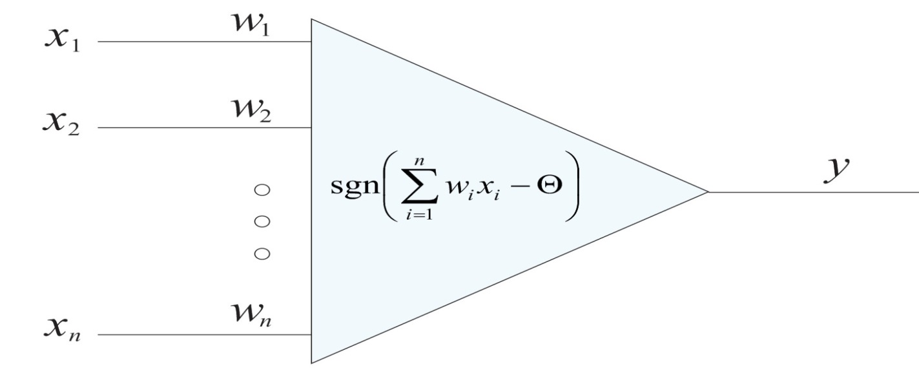
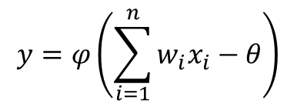
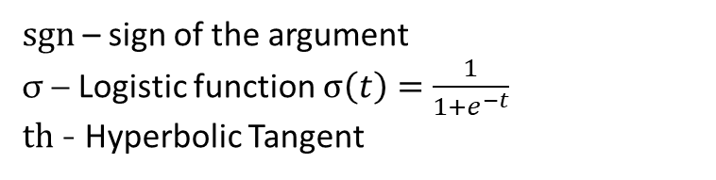
Artificial Neuron
$sgn$ – sign of the argument
σ – Logistic function $σ\left(t\right)=\frac{1}{1+e^{−t}}$
$th$ - Hyperbolic Tangent
$$y=φ\left(\sum_{i=1}^{n}{w_{i}x_{i}−θ}\right)$$

Slide 11
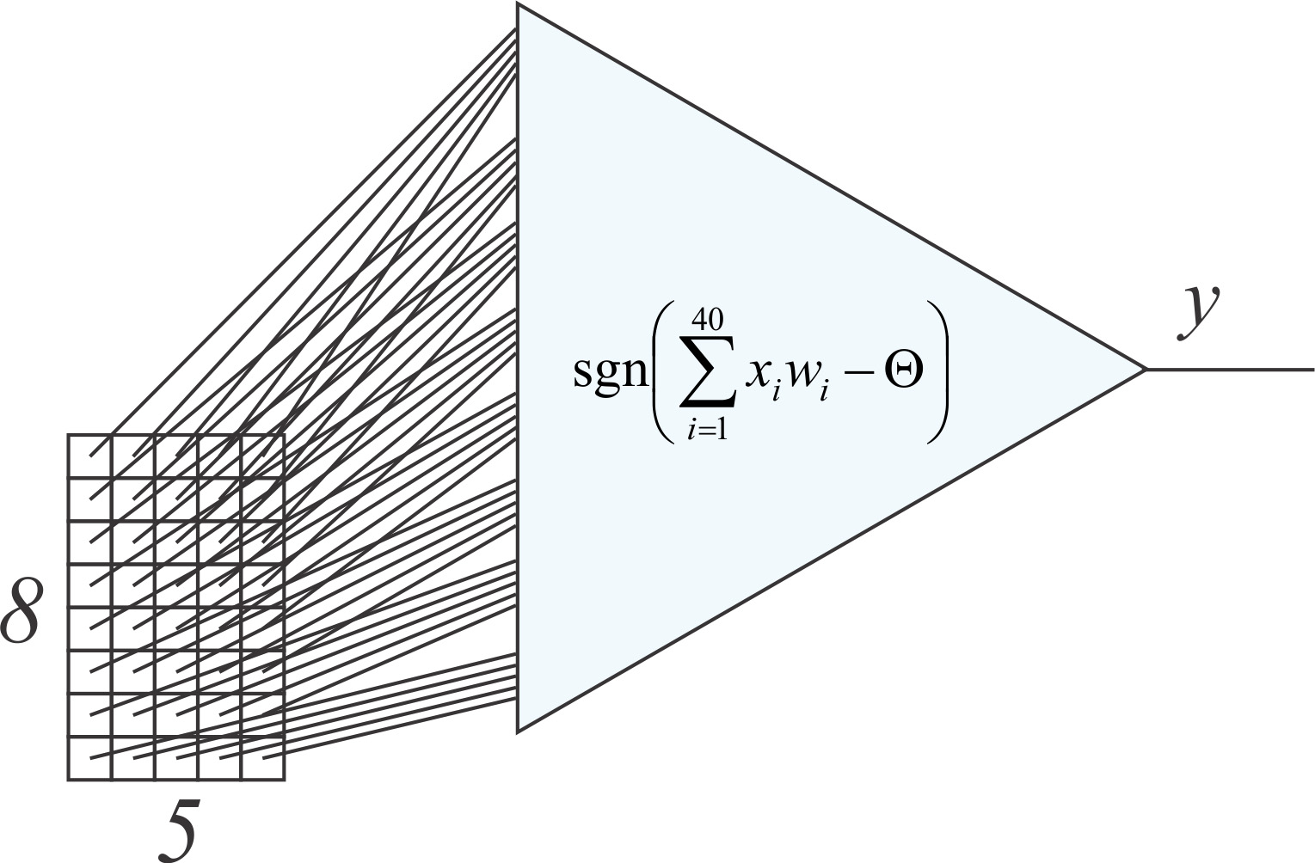
Image Recognition

Slide 12
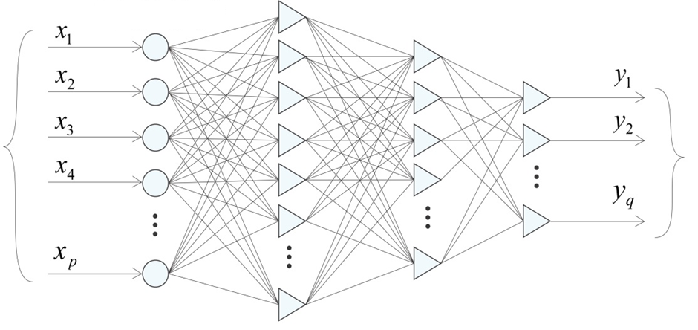
Multilayer Neural Network
Signal
Distribution
Input Signals
Output Signals
Hidden Layer of Neurons
Hidden Layer of Neurons
Hidden Layer of Neurons

Slide 13
Are You Using ChatGPT?

Slide 14

How Does ChatGPT Work?
Text generation is learned by the neural network through training on a large amount of text.

Slide 15
How Does ChatGPT Work?
ChatGPT is a neural network where text is provided as input, and text is generated as output.
Text generation happens gradually, with each subsequent word determined based on the preceding text.
Essentially, this model attempts to predict the next word based on the previous words.

Slide 16
This is amazing!

Slide 17
ეს საოცარია!

Slide 18
A network trained solely on text has acquired logical skills!

Slide 19
New Opportunities for Students
A great advisor has emerged who knows almost everything.
Artificial Intelligence can assist us in learning.
It can also help us avoid learning, if that's what we choose.

Slide 20
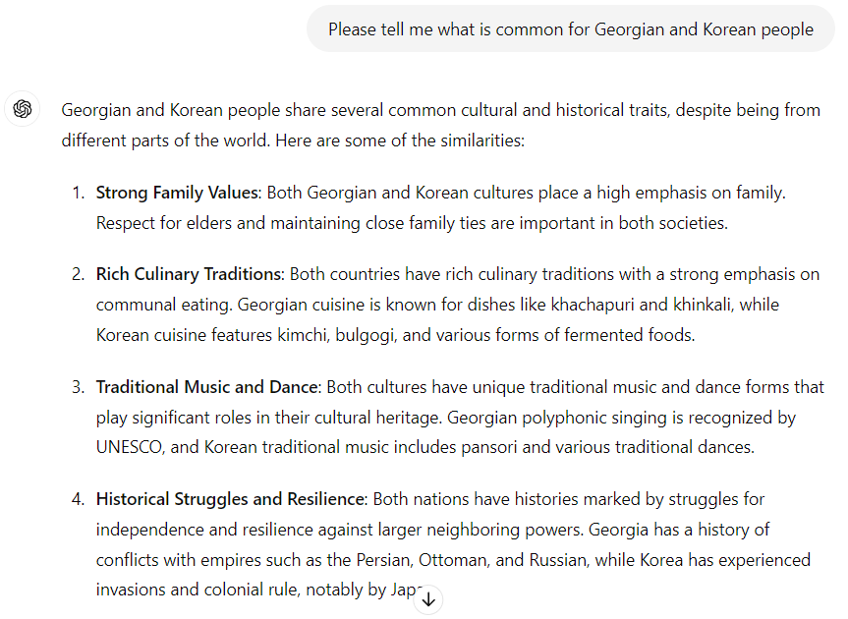

Slide 21
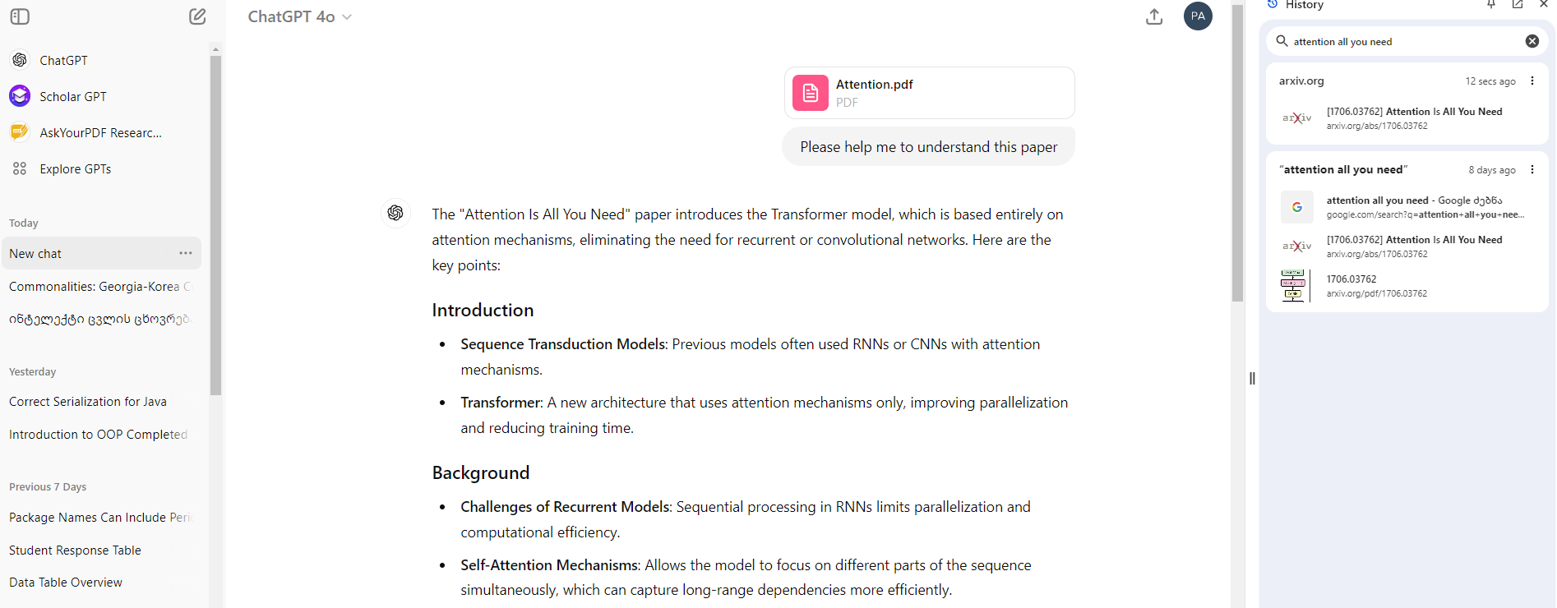

Slide 22

Should We Use a Calculator During Exams?

Slide 23

Should We Use LLMs (e.g., ChatGPT, Claude, Gemini, ...) During Exams?

Slide 24
New Opportunities for Lecturers
With the help of Artificial Intelligence, it is possible to quickly create assignments without programming knowledge.
Artificial Intelligence allows for more complex assignments to be given to students!
Using Artificial Intelligence also presents us with new challenges.

Slide 25
Creating Assignments
This is my list of students:
George,
Nino,
Paata,
Lekso,
Sam.
Could you please think of a free topic for each of them, which they will write as homework?

Slide 26
Creating Assignments
George: "The Impact of Cultural Exchange Programs on International Understanding“
Explore how cultural exchange programs (such as study abroad, student exchange, and work-study programs) influence the participants' understanding of different cultures and promote global peace.

Slide 27
Creating Assignments
Nino: "Cultural Differences in Communication Styles: A Comparative Study“
Analyze how different cultures communicate, focusing on verbal and non-verbal communication styles, and how these differences can lead to misunderstandings or enrich intercultural interactions.

Slide 28
Creating Assignments
Paata: "The Role of Media in Shaping Perceptions of Different Cultures“
Investigate how various forms of media (news, movies, social media) portray different cultures and the impact this has on intercultural relations and stereotypes.

Slide 29
Creating Assignments
Lekso: "Intercultural Marriage: Challenges and Benefits“
Discuss the unique challenges and benefits that arise in intercultural marriages, including family dynamics, cultural traditions, and raising children with multiple cultural identities.

Slide 30
Creating Assignments
Sam: "The Influence of Cultural Heritage on Modern Identity“
Examine how cultural heritage and traditions shape individual and collective identities in a globalized world, with examples from various cultural backgrounds.

Slide 31

Artificial Intelligence can also take on the role of a personal coach.
For example, here is a language teacher: https://gliglish.com

Slide 32
Chatbots can provide consultations in the educational space
Faculty Member: Can this student take "Histology," "Medical Ethics," "Calculus," and "General Biology" together this semester?
AI Consultant: Although the prerequisites for these subjects allow it, we face a legislative regulation that prohibits a load of more than 75 credits over two consecutive semesters. This student had a 40-credit load last semester, so they can only take up to 30 credits this semester. However, the total credits for the subjects you mentioned is 32.

Slide 33
მხოლოდ ენის მოდელები დაიხვეწა ბოლო დროს?

Slide 34
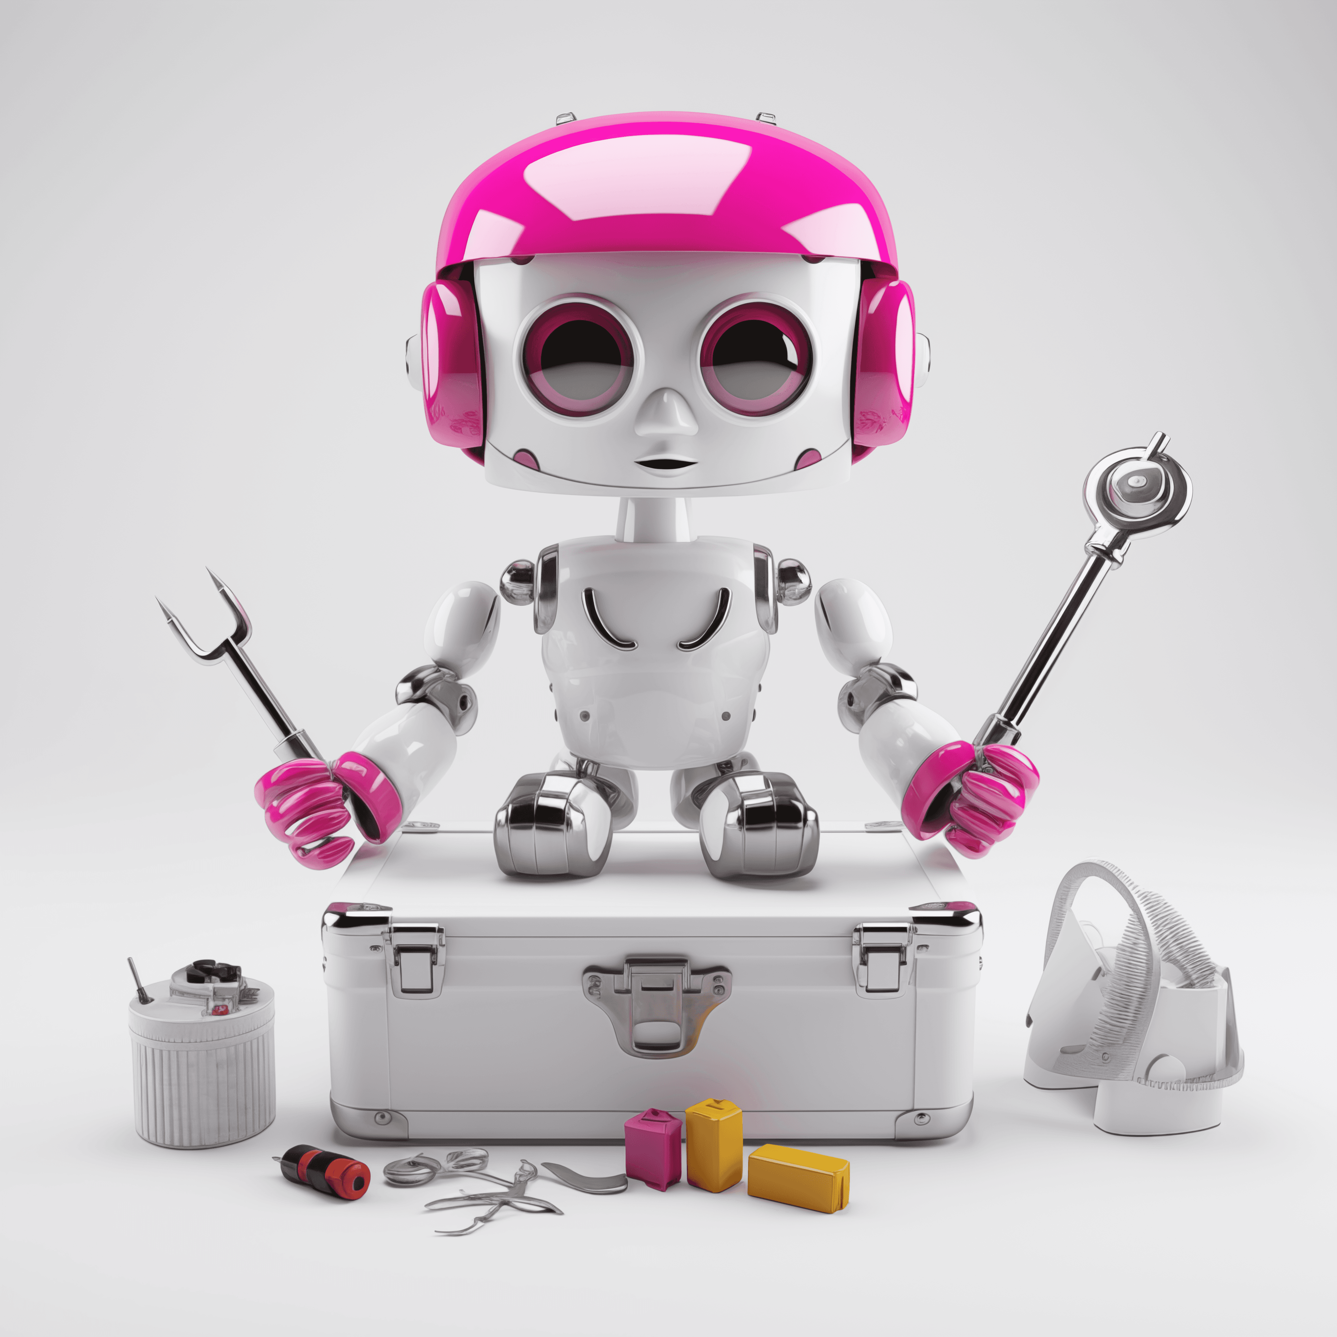
AI Agents
An Artificial Intelligence agent is software that equips AI with tools. For example, let's consider Crew AI.

Slide 35
Will Artificial Intelligence Replace Us?
?

Slide 36
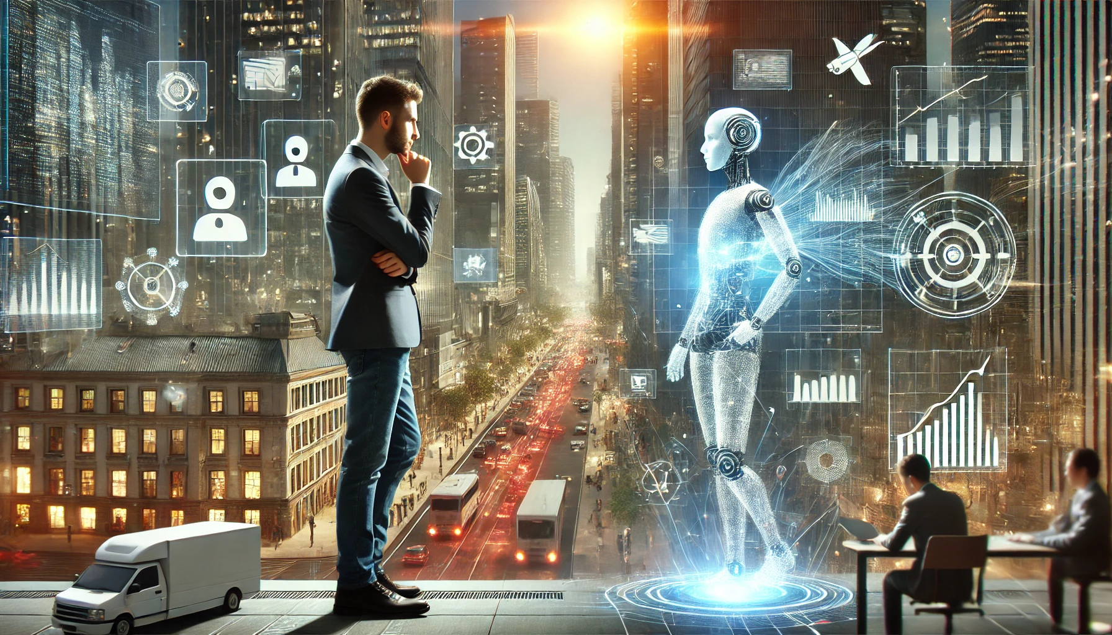

Slide 37
Thank you for your attention!

